Slide 1
OOP Final Programming Test Instruction
There are three questions.
In total, there are 100 points.
You must use the template to implement all of them.

Slide 2
We will rebuild your program to mark it. Delete all the .exe file(s) before marking. If you do not use the template to implement, your score is zero.

Slide 3
Instruction
Write your programs using Visual Studio 2019 on the .NET platform. The compiler version must be v142.
Open the project: SOGLFramework.sln. We will rebuild your program in the Release mode and check your program.
How to run the program? You can find the executable file SelfMotivatedSystem.exe in ./bin/Release

Slide 4
Main Task (MUST IMPLEMENT)
You must enter your information
student name, student ID, email address
in mySystemApp.h
//********************************************
// Student Name:
// Student ID:
// Student Email Address:
//********************************************
Set your name and student ID to cn_StudentInfo
in mySystemApp.h
If you do not do so, your score is zero.
You must not modify anything else in mySystemApp.h

Slide 5
Main Task (MUST IMPLEMENT)
You must enter your information:
student name, student ID, email address in the following function in mySystemApp.cpp.
void MY_SYSTEM_APP::showStudentInfo_2022( ) const {
cout << "*******************************" << endl;
cout << "OOP Final Programming Exam" << endl;
cout << "Date:2022/06/16\t" << endl;
cout << "Student ID:\t" << endl;
cout << "Student Name:\t" << endl;
cout << "Student Email:\t" << endl;
cout << "*******************************" << endl;
}
If you do not do so, your score is zero.
You must not modify anything else in mySystemApp.cpp

Slide 6
Files can be modified
You can add new functions/methods or delete existing functions/methods.
You can only modify the following files in
./00Student_Work/00_SimpleInteractiveSystem
mySystem_2048.cpp
mySystem_2048.h
mySystem_2048_draw.cpp
mySystem_GraphSystem.cpp
mySystem_GraphSystem.h
mySystem_GraphSystem_draw.cpp
mySystem_ImageEditor.cpp
mySystem_ImageEditor.h
mySystem_ImageEditor_draw.cpp
You must not modify other files that are not listed here.
If you have finished assignment THREE, you are suggested to copy these files to the provided template. YOU MUST NOT modify other files.

Slide 7
About the demo program(s)/figure(s)
If there is a demo program/figure(s), it/they may have bugs. It/they shows you some functions that are relevant to the questions. But some of the functions may be incorrect. It is for your own reference.
You must follow the instruction to finish the questions. We mark your programs based on the instruction.

Slide 8
System key usage
You must finish the option for key F5 to score and otherwise your score is zero.
F1: The Graph system (45%)
F2: 2048 (45%)
F4: Image processing (10%)
F5: Show student information on the top bar
‘s’: Show student information on the console window
ESC: quit the program

Slide 9
Question 1. Graph System. Key F1
There are four tasks. You must implement all of them.

Slide 10
Question 1. Graph System. Key F1
Implement a graph system
Add nodes
Add edges. The edge length must be around 5, i.e., 3, 4, 5, 6, 7.
Reset the graph structure
Handle some key events to manipulate some graphs
There are FOUR tasks to implement
Note: your program does not need to handle the mouse events, e.g., clicking and passive mouse move.

Slide 11
Question 1
You can modify GRAPH_NODE and GRAPH_EDGE
in graph_basics.h
You do not need to handle the following pointers:
mSelectedNode is the selected node
mPassiveSelectedNode is the passive node
Always set them to nullptr.

Slide 12
Question 1.
Add new functions when necessary.
Implement the following functions:
void handleKeyPressedEvent( unsigned char key )
int getNumOfNodes( ) const
int getNumOfEdges( ) const
vector3 getNodePositionOfEdge( int edgeIndex, int nodeIndex ) const;
void getNodeInfo( int nodeIndex, double &r, vector3 &p ) const;

Slide 13
Question 1: Task One
1. Press key ‘6’ shows the following graph:
1
The node with index 1 is at the origin position.

Slide 14
Question 1: Task Two
2. Press key ‘7’ shows the following graph:
The node with index 1 is at the origin position.
1

Slide 15
Question 1: Task Two – Hint One
(0,4)
(1,4)
(2,4)
(3,4)
2. Use two counters, namely spiral_x and spiral_y, to monitor the progress of the construction of the graph. Assign a pair of coordinates to each node.
Create the nodes in the order along the curve. When you create two adjacent nodes, simply add the edge between the two nodes too.
(4,4)
(0,3)
(4,3)
(0,2)
(4,2)
(0,1)
(4,1)
1
(0,0)
(1,0)
(2,0)
(3,0)
(4,0)

Slide 16
Question 1: Task Two – Hint Two
(0,4)
(1,4)
(2,4)
(3,4)
2. Use two counters, namely spiral_x and spiral_y, to monitor the progress of the construction of the graph. Assign a pair of coordinates to each node.
Use a double-for loop to create all the nodes and edges. Then use the delete function to delete the redundant edges.
(4,4)
(0,3)
(4,3)
(0,2)
(4,2)
(0,1)
(4,1)
1
(0,0)
(1,0)
(2,0)
(3,0)
(4,0)

Slide 17
Question 1: Task Three
3. Press key ‘8’ to incrementally create a graph which consists of a set of columns organized from left to right. A column has 5 nodes and 4 edges.
For each key event, one column is created. Your program must be able to create at least 4 columns. If another key (not ‘8’) is pressed, then this graph must be reset.
Press ‘8’ for the first time
Press ‘8’ for the second time
Press ‘8’ for the third time
Press ‘8’ for the forth time
1
1
1
1
The node (at lower left corner) with index 1 is at the origin position.

Slide 18
Question 1: Task Three - Hint
3. Use a variable, namely, counter_columns, to count the number of columns that have been created. Thus, you can create the next column based on the value of the counter. Make sure that you initialize it to zero.
void createColumns( ) {
if (counter_columns==0) {
reset( ); // reset graph
create_first_column…
}
if (counter_columns==1) {
create_second_column…
}
if (counter_columns==2) {
create_third_column…
}
…
++ counter_columns;
}
When counter_columns == 0, create the first column. After that increase its value by one.
When counter_columns == 1, create the second column. After that increase its value by one.
Press ‘8’ for the first time
Press ‘8’ for the second time

Slide 19
Question 1: Task Four
4. Press key ‘9’ to incrementally create a graph. The graph has one node after key ‘9’ is pressed for the first time. After that when key ‘9’ is pressed, create one node and one edge. If another key (not ‘9’) is pressed, then this graph must be reset. Your program must be able to handle at least 20 times for pressing ‘9’.
20
19
18
17
16
The index of a node indicates the creation order of the node.
For example, the node with index 3 is created when ‘4’ is pressed for the third time.
Press ‘9’ for 20 times to create the graph on the left.
The numbers are indices of the nodes.
11
12
13
14
15
10
9
8
7
6
1
2
3
4
5

Slide 20
Question 1: Task Four
Press key ‘9’ for the first time
Press key ‘9’ for the first 18 times
Press key ‘9’ for the first 3 times

Slide 21
Question 1: Task Four - Hint
Use two counters, namely snake_x and snake_y, to monitor the progress of the construction of the graph. Assign a pair of coordinates to each node. Furthermore, we use a variable, snake_previous_nodeID, to store the node that is most recently created.
(0,3)
(4,3)
(0,2)
(4,2)
(0,1)
(4,1)
1
(0,0)
(1,0)
(2,0)
(3,0)
(4,0)

Slide 22
Question 1: Task Four - Hint
void createSnake( ) {
if (snaka_x==0 && snake_y==0) reset( );
x = snake_x * edge_length;
y = snake_y * edge_length;
node_id = addNode …
if (snake_previous_nodeID >=0) {
addEdge(snake_previous_nodeID, node_id);
}
snake_previous_nodeID = node_id;
switch( snake_y ) {
case 0: snake_x++; // first row
if (snake_x>4) {
snake_x = 4; snake_y++;
}
break;
case 1: snake_x--; // second row
if (snake_x<0) {
snake_x = 0; snake_y++;
}
break;
…
}
}
Use a switch block to determine how to update snake_x and snake_y. Assume that (snake_x, snake_y) are the coordinates of the node to be created. Based on snake_y, snake_x is changed accordingly.
snake_x--
(0,3)
(4,3)
snake_x++
(0,2)
(4,2)
snake_x--
(0,1)
(4,1)
snake_x++
1
(0,0)
(1,0)
(2,0)
(3,0)
(4,0)

Slide 23
Question 1: Marking Scheme
[20%] Task One: Show the graph at once. Press key ‘6’.
[15%] Task Two: Show the graph at once. Press key ‘7’.
[5%] Task Three: Incrementally create the graph column by column by pressing key ‘8’.
[5%] Task Four: Incrementally create the graph node by node and edge (if any) by pressing key ‘9’.

Slide 24
Question 2. 2048. Key F2
This page is empty.

Slide 25
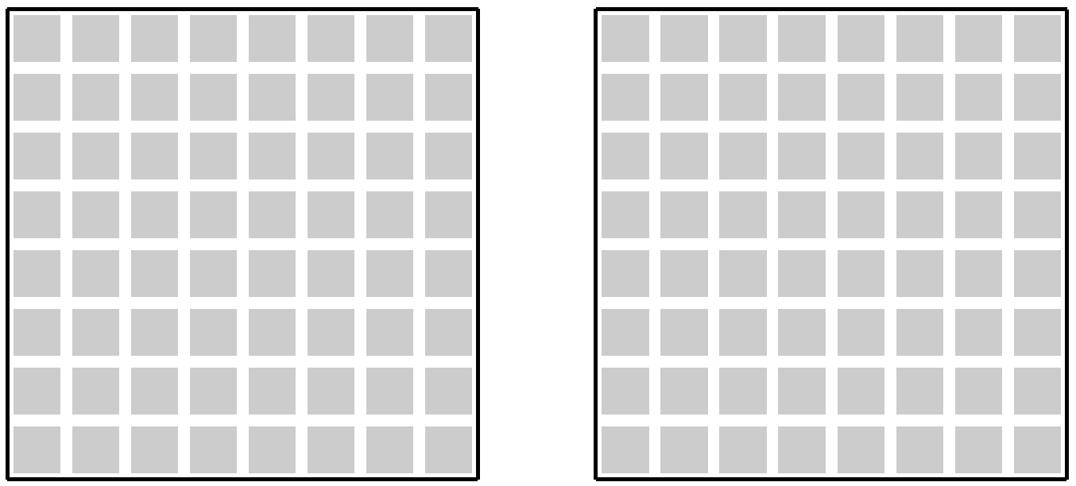
Question 2. 2048
Previous board
Current board
The dimension of the board is 8x8. So there are 8x8 blocks. A block may have a number: 2^1, 2^2, 2^3, …, 2^11.
If the block does not have a number, the block is empty.
Use the arrow keys and other keys to manipulate the board.
When an arrow key (up, down, left, or right) is pressed, a new number is generated at an empty block.
There are four possible directions to move the board: up, down, left, and right.
The numbers cannot be merged. We can move the numbers to one of the four possible directions at a time.
The gray squares are blocks. They are empty.

Slide 26
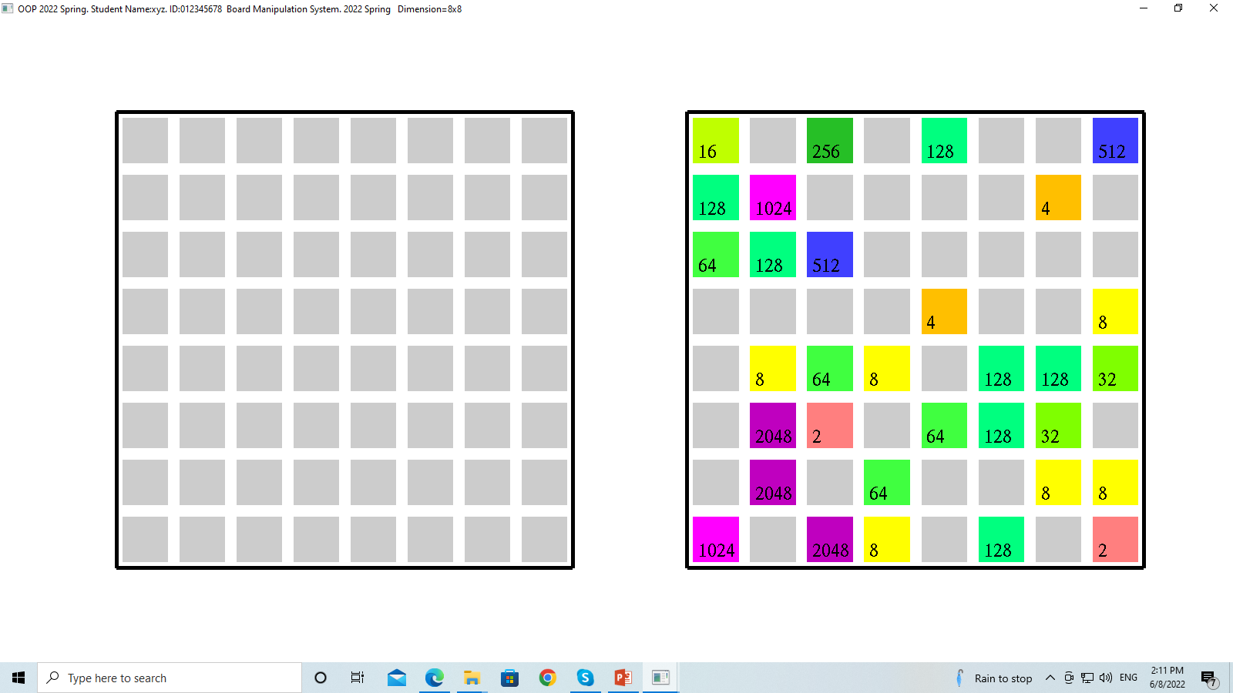
Question 2: Task One
Press key ‘6’ to generate randomly 32 numbers (i.e., 2^1, 2^2, 2^3, …, 2^11.)
The positions of these numbers are set randomly too.
Previous board
Current board

Slide 27
Question 2: Task One - Hint
This method does not work if it is very difficult to generate valid (i,j)
Press key ‘6’ to generate randomly 32 numbers (i.e., 2^1, 2^2, 2^3, …, 2^11.)
The positions of these numbers are set randomly too.
void generateHalfBoard( ) {
reset( );
for (int n = 0; n < 32 ++n) {
compute a random number
while (true) {
compute random i
compute random j
if board[i][j] non-empty
continue;
break;
} // end while
//generate one number
board[i][j] = number;
} // end for
}

Slide 28
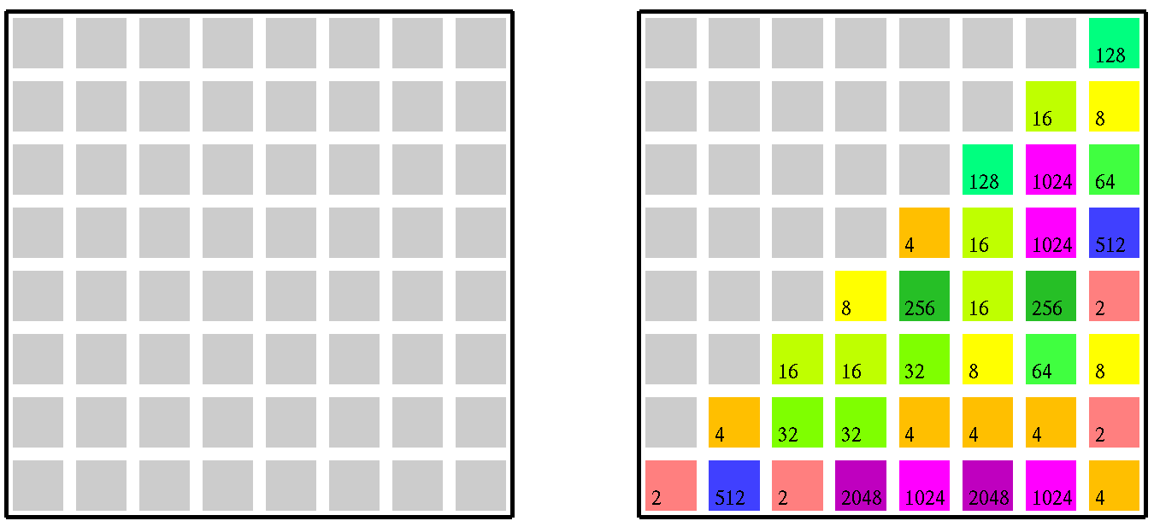
Question 2: Task Two
Press key ‘7’ to generate randomly the numbers and arranged them as a triangle, as shown in the following image on the right.
Previous board
Current board

Slide 29
Question 2: Task Three
When an arrow key (up, down, left, or right) is pressed, a new number is generated at an empty cell.
The new number is generated randomly. Its value is one of 11 numbers, i.e., 2^1, 2^2, 2^3, …, 2^11 (or 2, 4, 8, …, 2048).
There are four possible directions to move the board: left, down, left, right. Based on the movement direction, the numbers are moved.
The numbers cannot be merged.
You must implement to handle all the four key events.

Slide 30
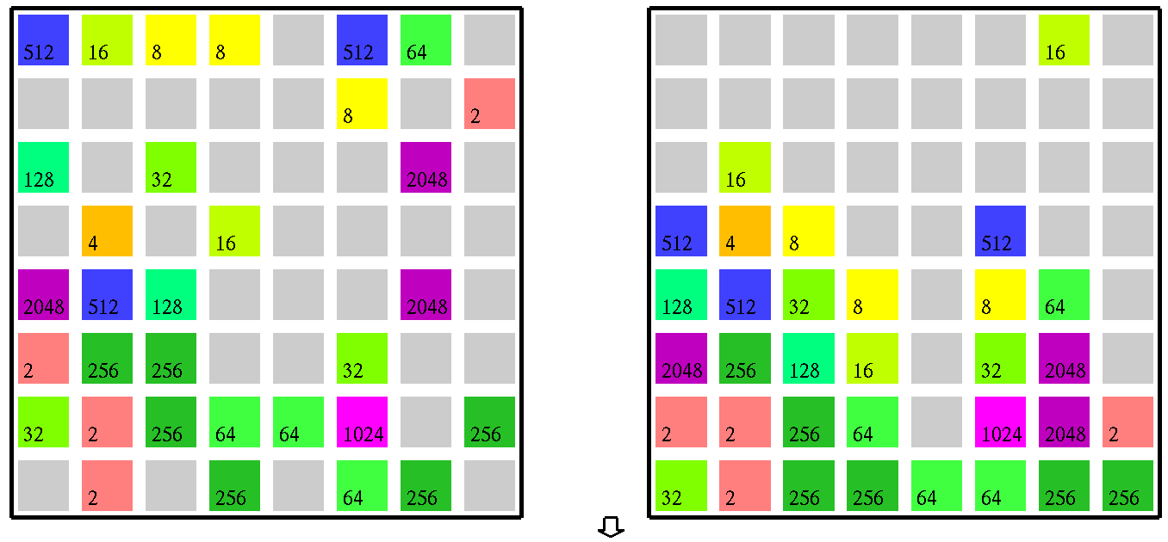
Question 2: Task Three – Example ‘Move down’
This example shows that the ‘down’ key is pressed. The numbers are moved downwards.
Two adjacent numbers with the same value are not merged.
You simply move all the numbers to the bottom of the board.
Previous board
Current board
Notice number 16 is generated at an empty block of the board after the key event is pressed.

Slide 31
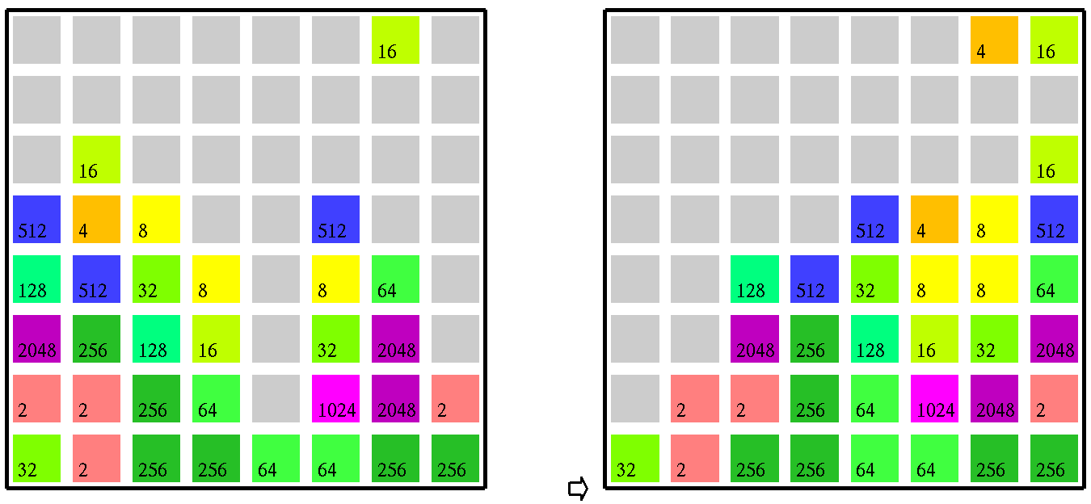
Question 2: Task Three – Example ‘Move Right’
This example shows that the ‘right’ key is pressed. The numbers are moved to right.
Two adjacent numbers with the same value are not merged.
You simply move all the numbers to the right side of the board.
Previous board
Current board
Notice number 4 is generated at an empty block after the key event is pressed.

Slide 32
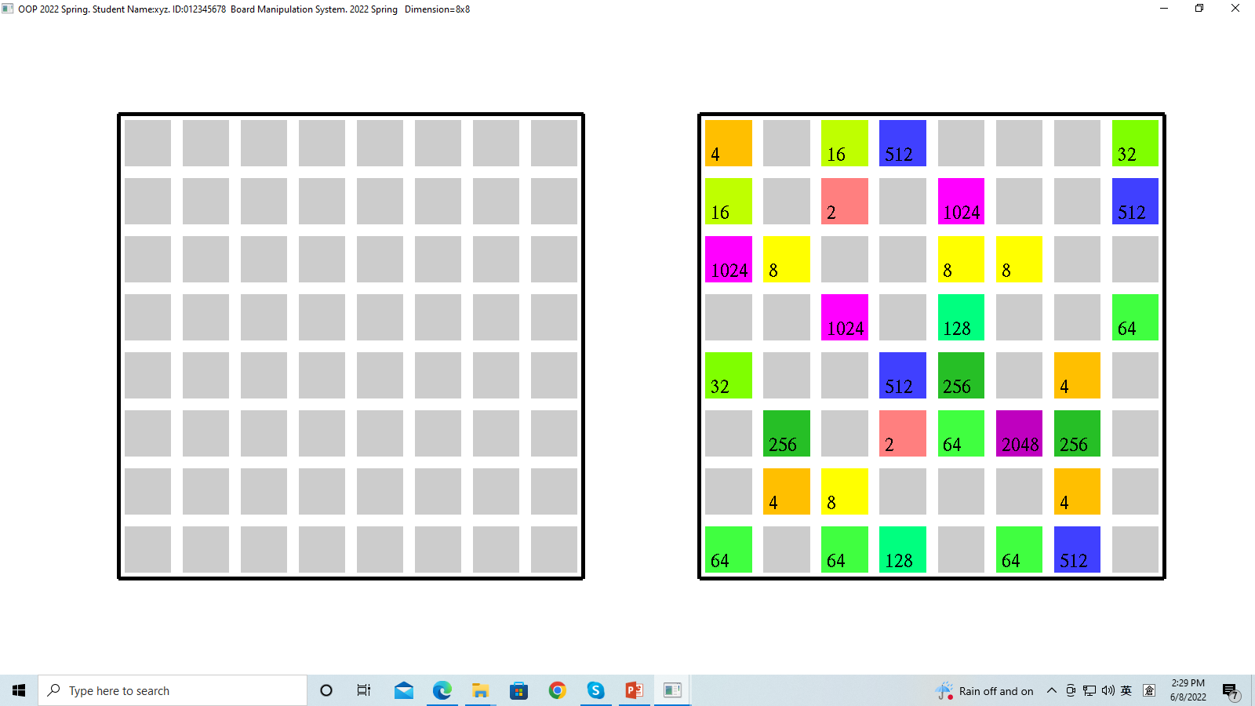
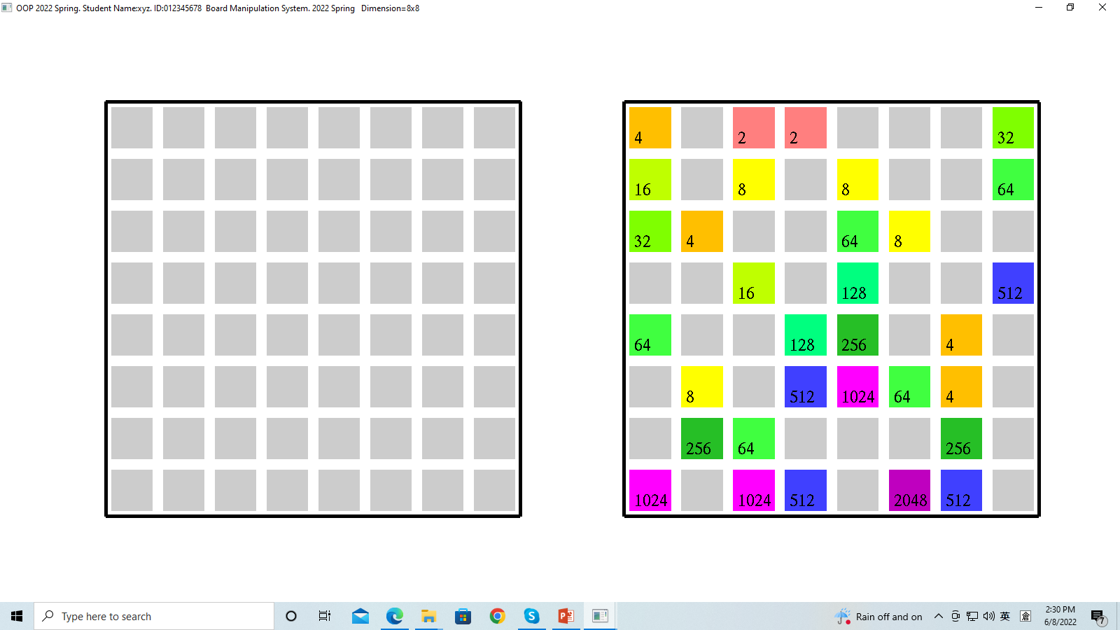
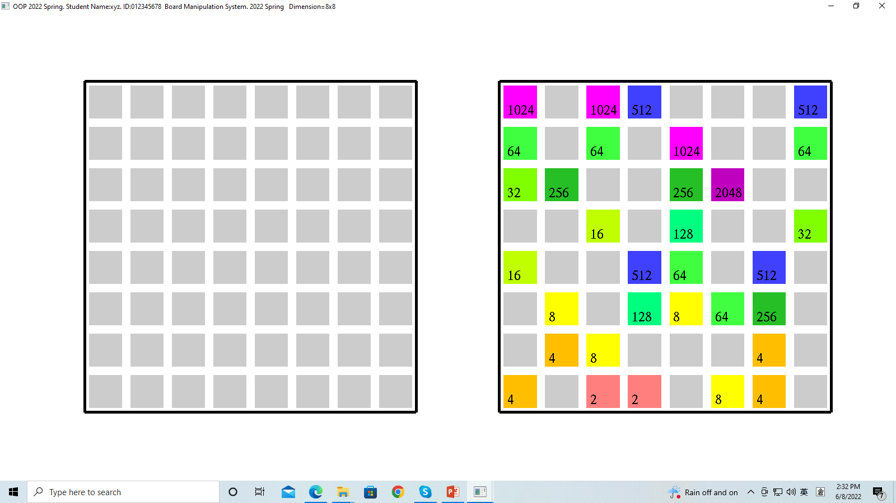
Question 2: Task Four – Sort numbers in columns
Press ‘m’ to sort the numbers in each column. The numbers must not be moved.
The numbers are either sorted in ascending or descending order.
The next time that ‘m’ is pressed, the numbers are sorted in another way.
Before sorting
‘m’ is pressed for the first time
‘m’ is pressed for the second time

Slide 33
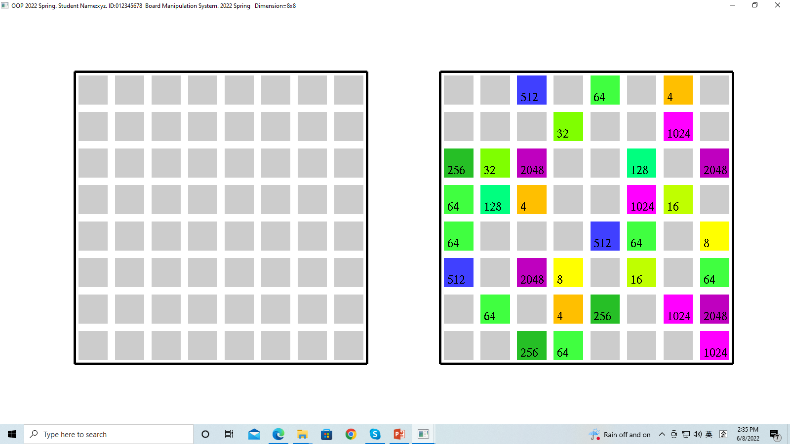
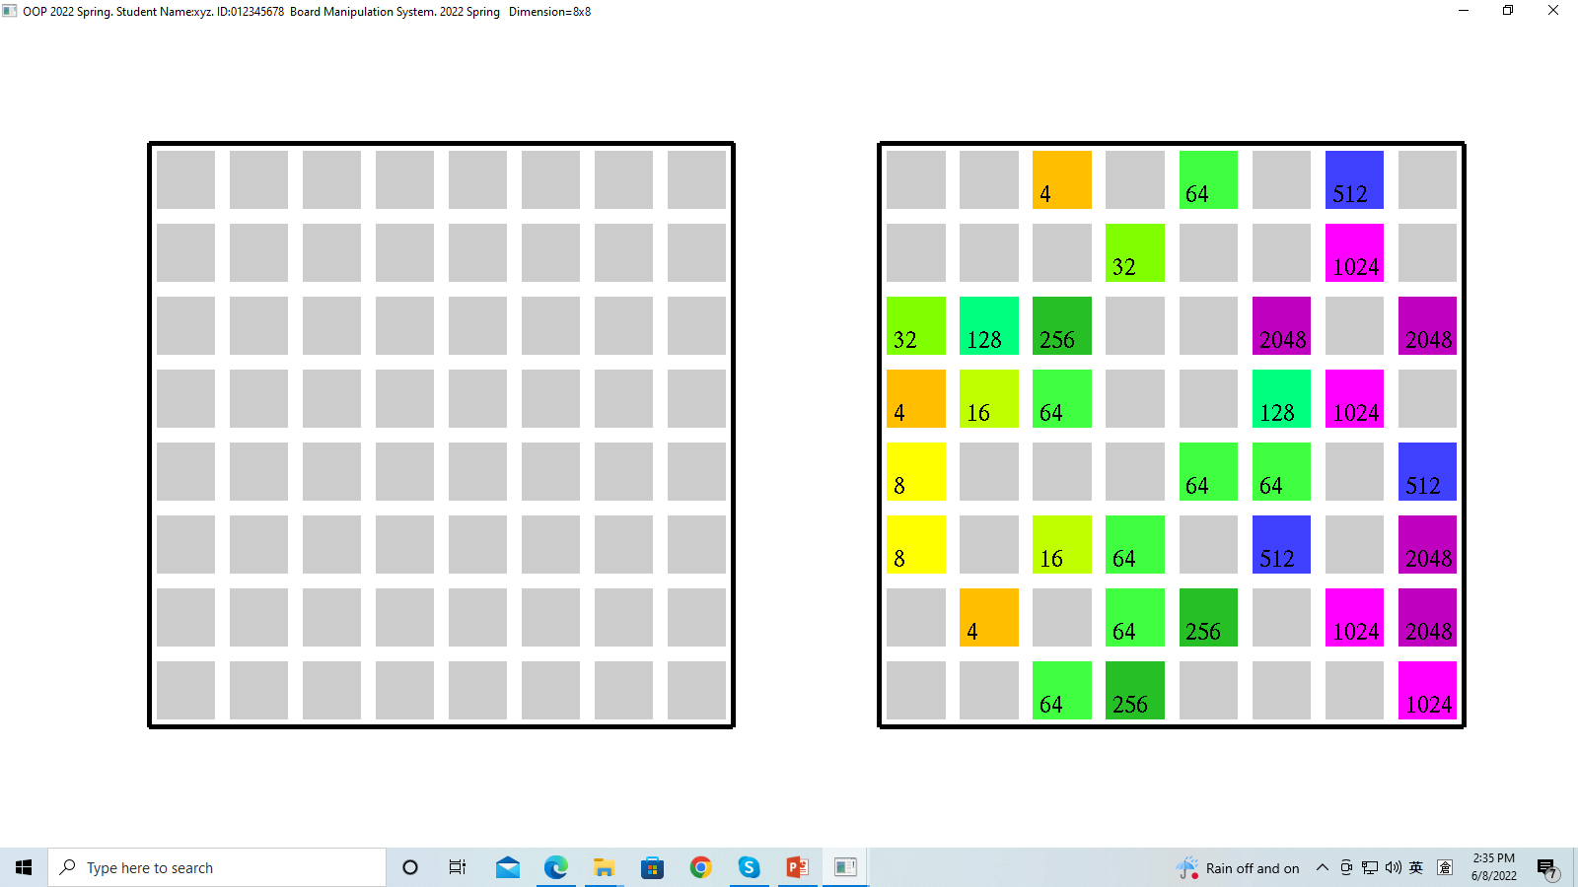
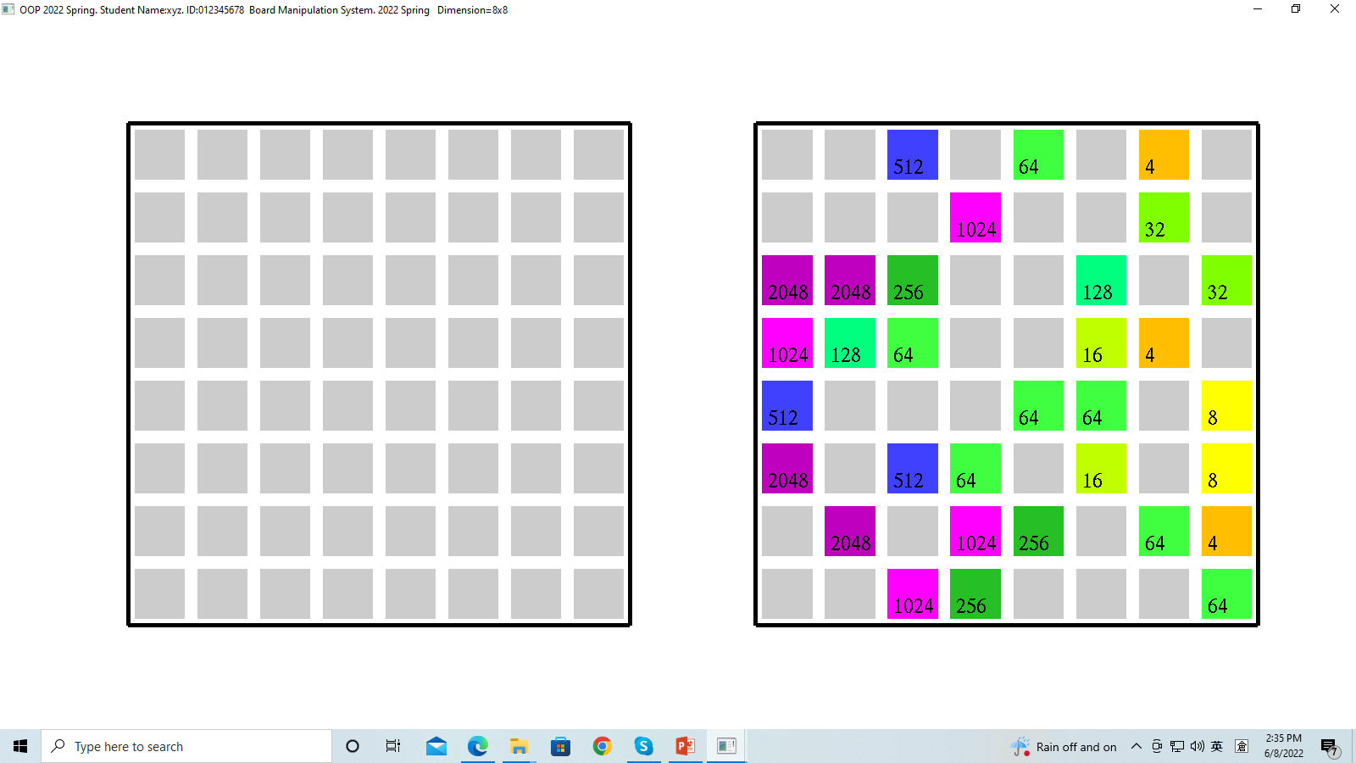
Question 2: Task Five – Sort numbers in rows
Press ‘n’ to sort the numbers in each row. The numbers must not be moved.
The numbers are either sorted in ascending or descending order.
The next time that ‘n’ is pressed, the numbers are sorted in another way.
Before sorting
‘n’ is pressed for the first time
‘n’ is pressed for the second time

Slide 34
Question 2: Marking Scheme
[15%] Task One: generate randomly 32 numbers
[10%] Task Two: triangle
[2.5%x4] Task Three. Down, up, left, and right movement directions
[3+2%] Task Four: ascending and descending order for each column
[3+2%] Task Five: ascending and descending order for each row

Slide 35
Question 3. Image processing. Key F4
This page is empty.

Slide 36
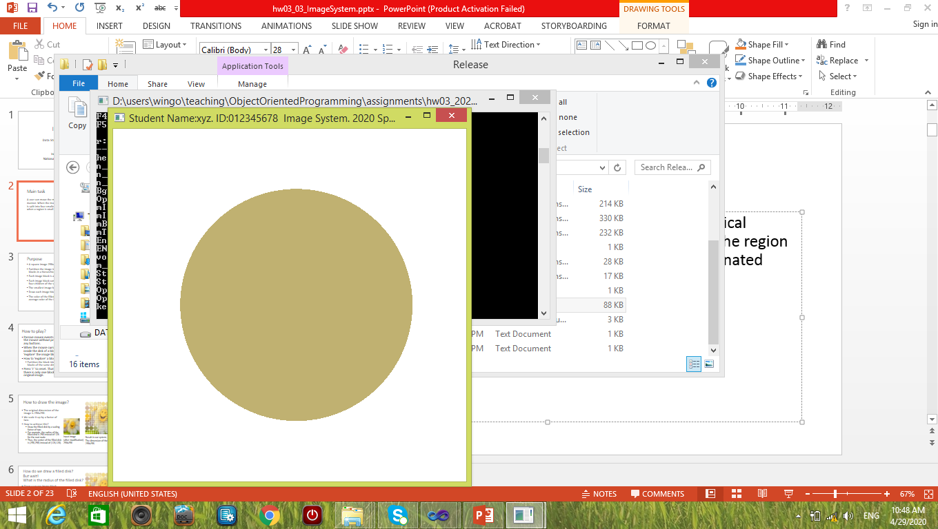
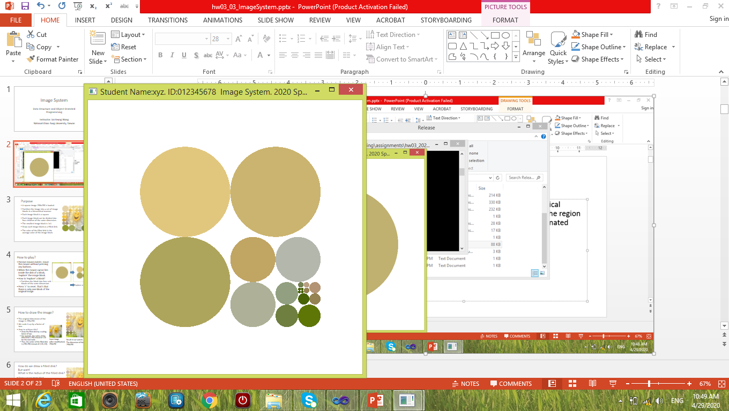
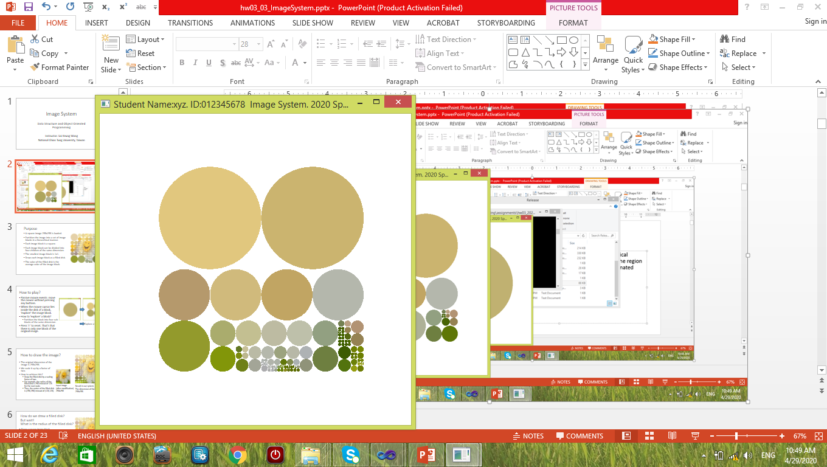
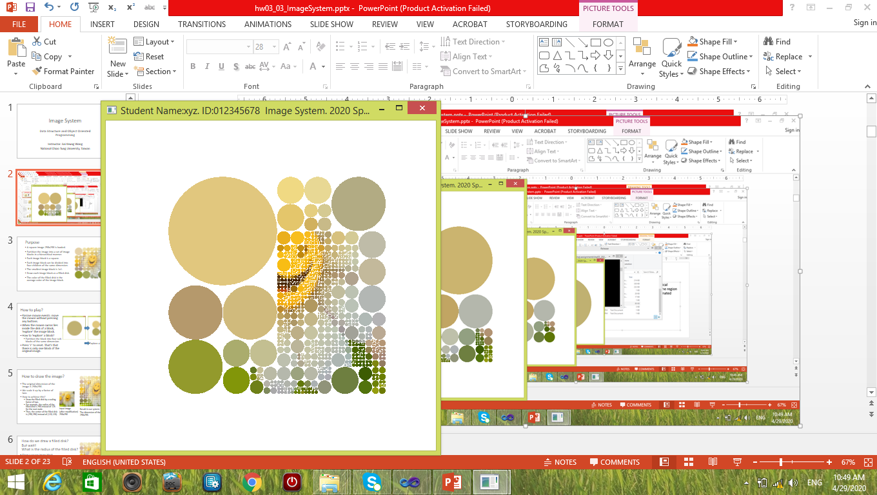
Question 3. Hierarchical structure and nodes
An image is composed of square regions. It can be explored in a hierarchical manner. An unexplored region can be split into four smaller regions. The splitting process is terminated when a region is small enough. Each region is called as a node.
Initially, the image is represented as a large filled disk.
The image is split at different stages.
A region is represented as a filled disk.

Slide 37
Question 3. Filled disks
A square region or a node of the image can be represented as a filled disk. Initially, the image is a large square region. Thus it is displayed as a large filled disk. After a region is split, four smaller regions are obtained. In other words, the node of the region has four children.
Initially, the image is represented as a large filled disk.
The image is split at different stages.
A region is represented as a filled disk.

Slide 38
Question 3. Node level
The large disk is at level one.
When a node is split, the level of its four children is increased by 1.
The following figure shows the levels of some nodes.
Level
Two
L.3
L.4
Level one
L.3
Initially, the image is represented as a large filled disk. The corresponding node level is one.

Slide 39
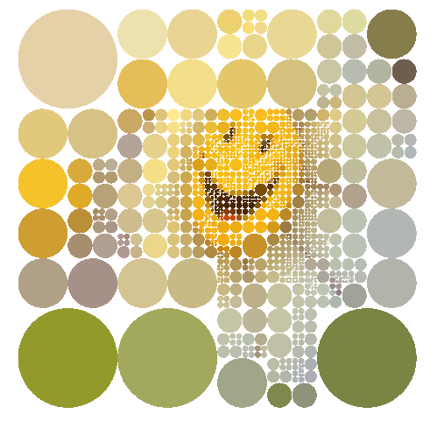
Introduction
A square image 256x256 is loaded.
Partition the image into a set of image regions in a hierarchical manner.
Each image region is a square.
Each image region can be divided into four children of the same dimension.
The smallest image region is 1x1.
Draw each image region as a filled disk.
The color of the filled disk is the average color of the image region.

Slide 40
Question 3: Main tasks
Use the key events to change the image.
Mouse events are not used in this question.

Slide 41
Question 3: Task One
Press ‘6’ to explore the image to the lowest level and show the disks at the lowest level.
No demo figure here.

Slide 42
Question 3: Task One - Hint
void explore_full( ) { // entry point
explore_full( m_root ); // pass the root node
}
void explore_full( IMAGE_NODE *node ) {
if (node->flg_explored) {
for each child {
explore_full( child );
}
return;
}
// set the node to be explored.
node->flg_explored = true;
if node region too small, return;
create four children
for each child
set the attributes (e.g., position, width, height, etc.)
for each child
explore_full( child );
}
Press ‘6’ to explore the image to the lowest level and show the disks at the lowest level.
Main idea
For each node, check whether it is explored. If not, explore it except for that it is too small. When a node is explored, its four children are created and then explore the four children.

Slide 43
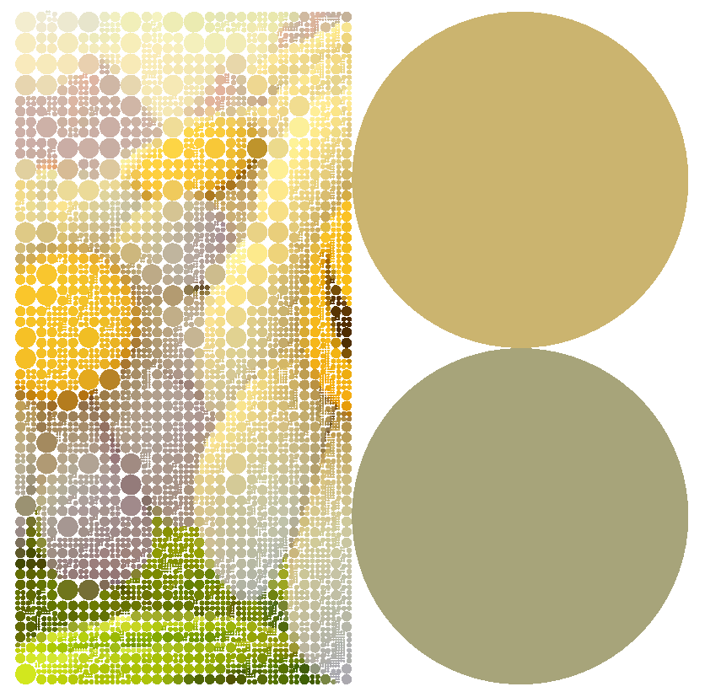
Question 3: Task Two
Press ‘7’ to explore the left side of the image.
The left part of the image must be explored to at least level 5 or higher.
Hint: You can directly explore a node without giving a point position.
Apply explore_full on the two left nodes

Slide 44
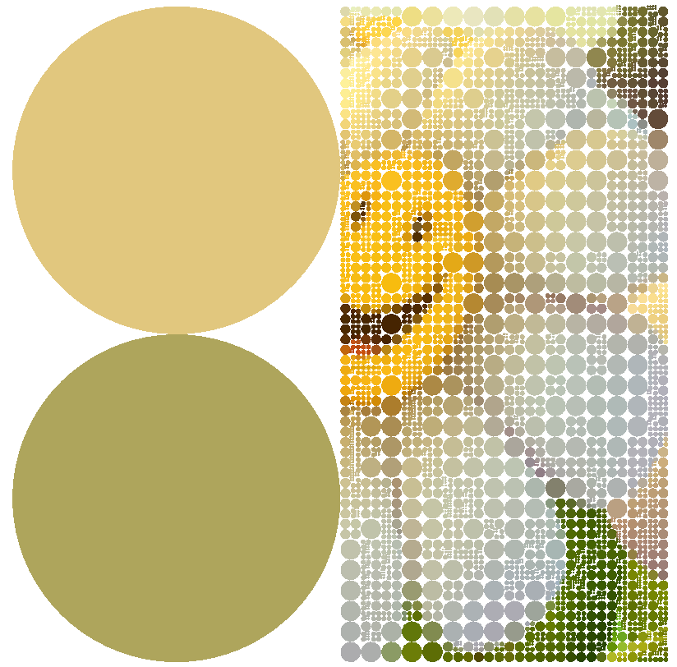
Question 3: Task Three
Press ‘8’ to explore the right side of the image.
The right part of the image must be explored to at least level 5 or higher.
Apply explore_full on the two right nodes

Slide 45
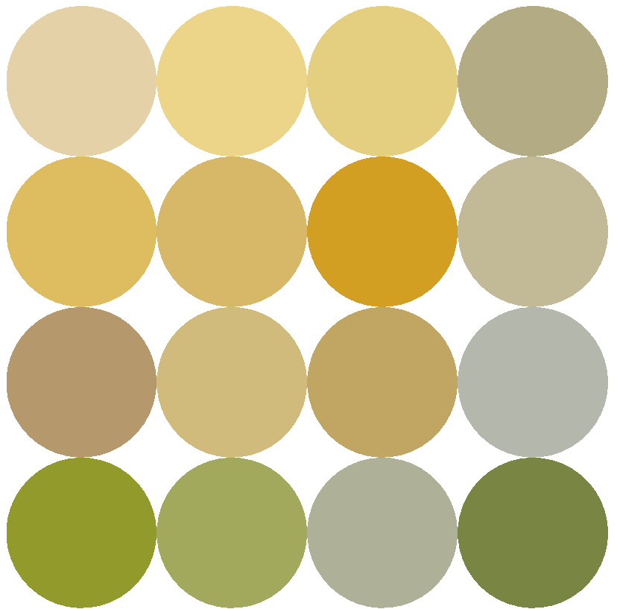
Question 3: Task Four
Press ‘9’ to display the image as shown below.
No demo figure here.
Show the image at level 3. All nodes are at level 3.

Slide 46
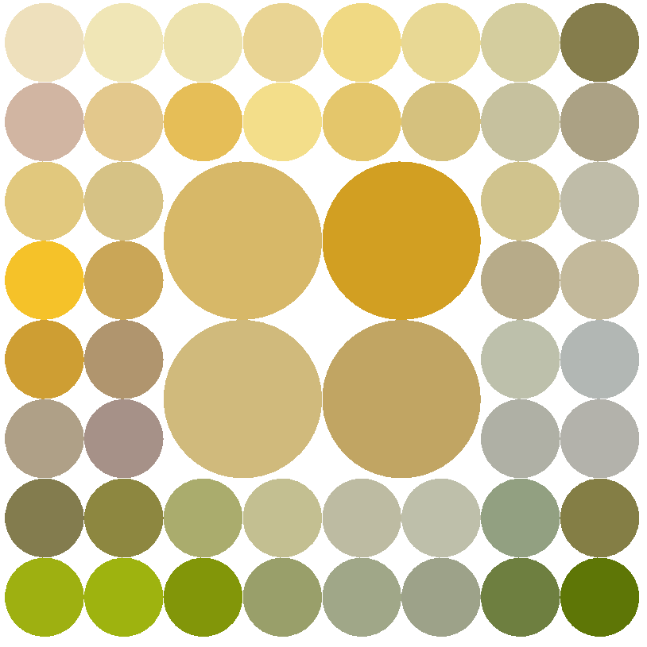
Question 3: Task Five
Press ‘0’ to show the image as the below figure.

Slide 47
Question 3: Task Five - Hint
Press ‘0’ to show the image as the below figure.
Main idea:
If you know the positions of the nodes at higher level,
Invoke the passive mouse function with the appropriate points (x,y) to explore the required nodes one by one.

Slide 48
Question 3: Marking Scheme
[2%] Task One: fully explore the image
[2%] Task Two: explore the left part of the image
[2%] Task Three: explore the right part of the image
[2%] Task Four: show the image at level 3. All nodes are at level 3.
[2%] Task Five : show the image with some explored nodes at certain levels

Slide 49
Question 3
This page is empty.

Slide 50
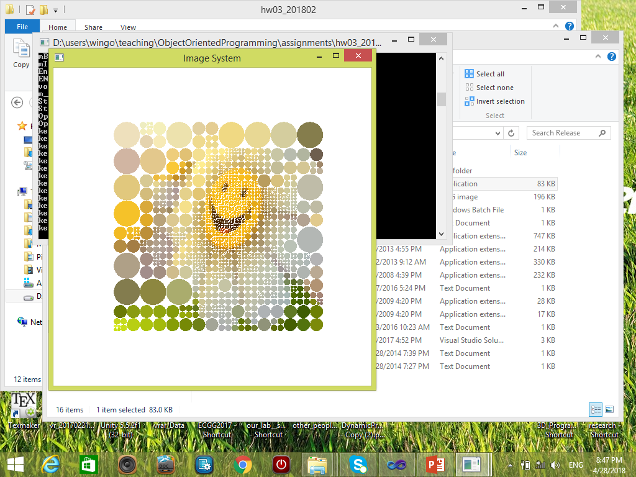
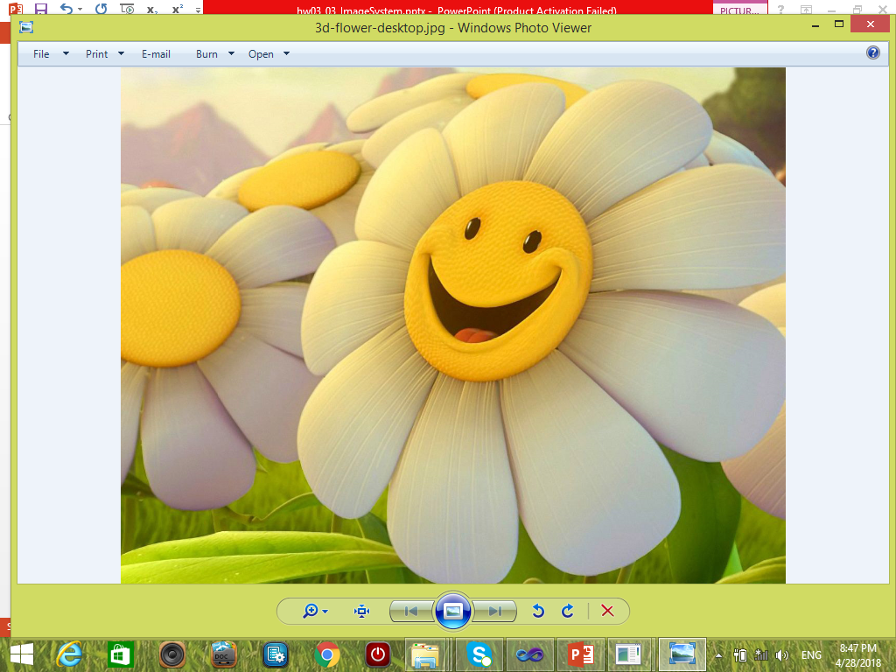
How to draw the image?
The original dimension of the image is 256x256.
We scale it up by a factor of two.
How to achieve this?
Draw the filled disk by a scaling factor of two.
For example, the radius of the filled disk is 256 instead of 128 for the root node.
Thus, the center of the filled disk is (256,256) instead of (128,128).
Input image
(after modification)
256x256
Result in our system.
The dimension of the image is 256x256.

Slide 51
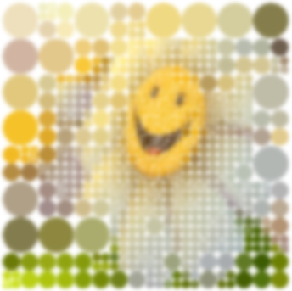
How do we draw a filled disk? But wait! What is the radius of the filled disk?
Given a square image region with dimension (w,w), what is the radius of the filled disk?
radius =?
radius = (w/2)*2 = w
This is because we scale it up by a factor of two.
2w
w
Input image
(after modified)
256x256
Result in our system.
The dimension of the image is still 256x256.

Slide 52
Average Color Computation
IMAGE_SYSTEM::computeNodeColor(IMAGE_NODE *node)
IMAGE_SYSTEM::computeAverageColor(
int start_x, int start_y,
int w, int h,
float &r, float &g, float &b
) const
Hint: call m_Image->getPixelColor(i, j, pr, pg, pb); to get color at pixel (i,j)

Slide 53
Draw the disks hierarchically
IMAGE_SYSTEM::draw_Disks_Dynamic( ) const
IMAGE_SYSTEM::draw_Disks_Dynamic( const IMAGE_NODE *node) const
Draw an IMAGE_NODE *node:
int wImage, hImage;
m_Image->getInfo(wImage, hImage);
node->drawDisk_TriangleFan( wImage, hImage);

Slide 54
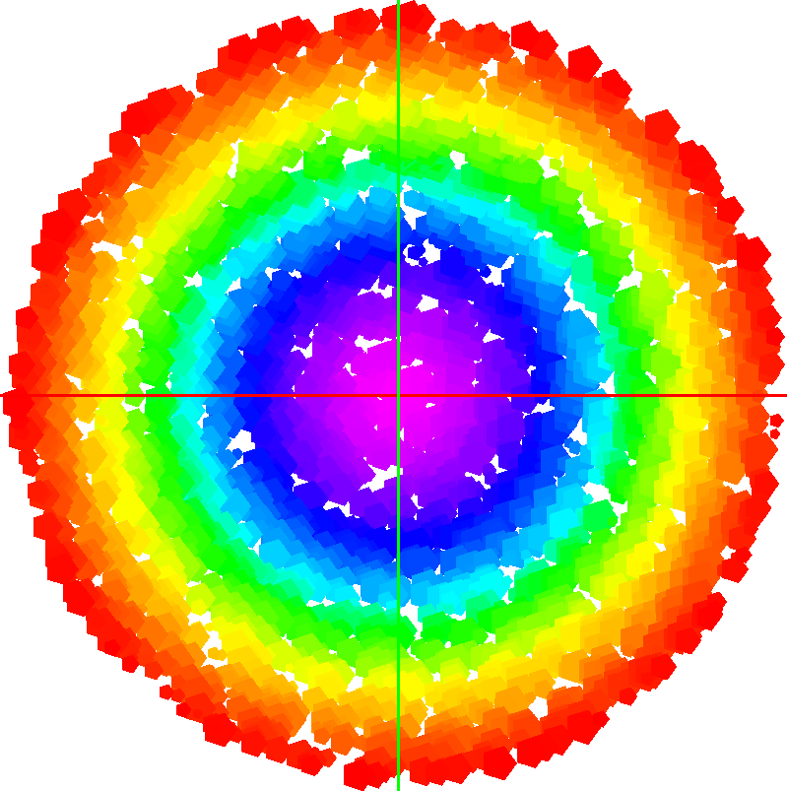
End
Enjoy programming!

